Slide 1





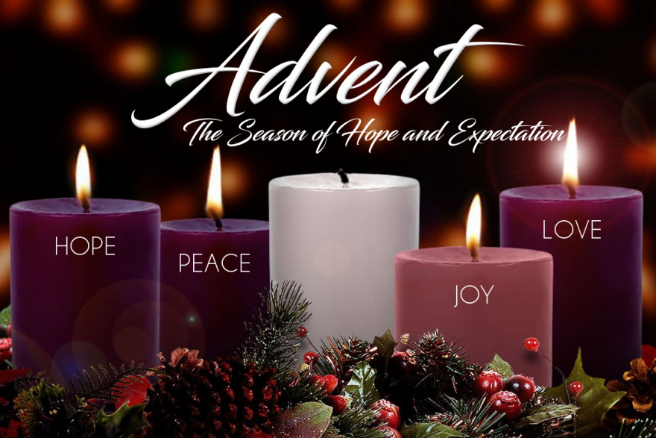
BREAKING WALLS OF TENSION AND OPENING
THE DOOR OF HOPE
BREAKING WALLS OF TENSION
OPENING
THE DOOR OF
HOPE
ADVENT WEBINAR
2024
Isaiah 11: 1-10

Slide 2
ADVENT
SEASON
ADVENT
It’s a moment of Grace, time of hoping and waiting for Christ’s birth in our live.
It’s a time of learning patience in the process as we wait the coming of the Messiah, the invisibile God, the Word made flesh (Col 1:15)
Awaited fulfilment of Christmas joys of the expected Messiah.
Season of waiting and preparation, journeying and hoping, focus our prayers on all the walls that separate and divide us, tear our lives apart, keep us locked up and in- themes of the season: hope, peace, love, and joy as a framework to address the essential mystery of incarnation, God-with-us, the Messiah, Emmanuel
In Hope and faith, we await the Prince of Peace to break down the dividing walls that separate us from incarnate love (Eph 2:14). Faith sustains Hope and Hope does not disappoint (Rom 5:5)- God has given us hope and faith that rises over disappointments , tensions and darkness.

Slide 3
    Tensions of life’s journey in our different contexts
INTERACTIVE MOMENT
    Tensions of life’s journey in our different contexts
    Painful and uncomfortable forces in life (social, spiritual, political, and cultural). Tensions in relationships, systems and the surroundings.
    The How response towards tensions in life is very crucial and drives us to healing, Hope, joy, inner peace, communion, development and prosperity.
    The Hope and Faith in Christ’s resurrection and the promise of the Messiah (Malachi 3:1).
Re-awaken our memories of God’s goodness-Isaiah
Open the Door of Hope, expected Messiah, Christmas joy

Slide 4
Breaking Walls of Tensions
Journey of hope built on pillars of faith and prayers focusing on the walls that separate and divide us, tear our lives apart, keep us locked up or locked in, keep us miserable in life-community.
Journey of transformation and conversion from different walls of darkness and tension, moment of reflection, shift of mindset and attitude.
Moment of facing our fears, uncertainties, anxiety, asking for willingness to accept the dark/tensional moments of our lives.
Hope helps each one of us to re-awaken the memories of God’s goodness in our life’s journey
It is time to cultivate Hope in our lives, communities, church, society and it’s a global necessity!!!!!
Advent themes of Hope, Peace, Love, and Joy lead us to the great MYSTERY OF INCARNATION
Christ Born among Us
Emmanuel
Verbum caro factum est!
“Christian Hope is a gift from God that fills our lives with joy. It is very necessary and the world needs it a lot!” Pope Francis

Slide 5
Tension in life- due to strained relationships that weigh down one’s spirit; happenings from a negative perspective; Trying to be all things to all people ending in disappointments.
                Pick up the tension, Throw off, pause and process with grace, look to the future with Hope
Tensions do not just melt away during Advent- Call on the continuous presence of God in every moment of our lives. We need to learn to pause and to process with grace; to have patience with ourselves and others in this wide-open space of the process of waiting with hope in Christ born for our salvation.
Advent speaks of peace, patience, waiting, abiding, being open to newness, allowing and accepting growth, a spirit of silence that is rich with meaning and depth. Be still, I am the Lord your God-Ps 46:10
Let’s question our Hope!
Is your hope centered in the person of Christ or something else?
Are you ready to “throw off the tensions from your life” in order to embrace the Door of Hope and Prince Peace? Does the Theme of Opening the Door of Hope resonate with you considering the present need of inclusion and celebration of difference in the multi-faith, multi-cultural society of today?

Slide 6
Let’s share the different tensions we experience in life’s journey today? all aspects of life
Personal, from the community, society, church , social relationships and connections, spiritual, cultural, political, psychological and emotional tensions.
Reflection
Personal/Group Sharing
How are we navigating into these tensions towards the Door of Hope with positive attitude and Hope of the Promised Messiah?
Pick one area to ‘throw off’ this Advent
Throw off all tensions this advent
Become a prophet of Hope, Love, Peace, Repentance and of the Incarnate Joy of Christmas.

Slide 7
Breaking Walls of Tensions
Fear and Insecurity
Blame and Victim (Right is mine and blame is the other)
I want it now attitude especially in the young generations brings tension. People want things and need them now even when some realities do not permit! Quick things with no toil!
Competition is fierce and survival at stake which rises communal/ societal tensions-Survival attitude
Family Tensions
Relationship tensions (conflicts and differences)
Work related tensions
Irrational thinking, biases and prejudices
Mental health problems and personality disorders
Political instabilities
Chronic stress which brings health risks

Slide 8
OPEN THE DOOR OF HOPE
Isaiah 11: 1-10 – Advent call to new life
Isaiah 11 gives us hope that new life will spring forth from an injured stump: “A shoot shall come out from the stump of Jesse, and a branch shall grow out of his roots.”
The concrete expression of this new life, new beginning, new hope, new happiness invites us to open our hearts and trust the work of the Holy Spirit into our daily encounters (V.2)
Encounter with humanity-networking- unity in diversity- accepting one another’s vulnerability. It’s a communal journey as pilgrims of hope, called to cast the net with hope for abundant harvest.
Isaiah proclaims the Vision of re-ordered creation- Think of the shift of mindset and attitude and openness to newness
God’s new creation is our promised destiny, a place where peace, justice, and grace have the final word and its our duty in this advent to work towards this final destiny, the messianic completion of creation.
      “The one who has hope lives differently” (Pope Benedict XVI)

Slide 9
Proclamation of God’s Kingdom
“In the days of the Messiah of Israel, peace shall be multiplied in the earth. The wild and tame creatures shall agree together. …...”
Universal call to holiness- the kingdom of the Messiah is a kingdom of peace, righteousness; of happiness and holiness. Together in the journey to holiness
When the door of Hope opens
Tensions, conflicts, wars, insecurities, violence, corruption and all sorts of injustices come to an end
AND
Peace, joy, love, harmony shall flourish.
Communion and solidarity shall prevail,
Acceptance of each one’s vulnerability; appreciation of differences /creative parts of each other in the society and community will thrive into transformed society, community, systems, and self.

Slide 10
Fruits of the Messianic Hope
The messianic hope creates space for reconciliation and forgiveness, detachment-letting-go attitude, shift of mindset to peaceful co-existence as God’s chosen ones. We are all pilgrims of Hope!
Building bridges and becoming a bridge with creative - positive and meaningful relationships that go beyond human judgements/put aside comfort zones, take risks. Prophets of Hope dare to risk hope
Celebrate and appreciate diversity and giftedness of every one in a community. Creating opportunities for collaboration and partnership as means of connecting and discoveries.
Openness to new realities/ readiness to embrace change/ creating space to talk about it for a greater move, growth, development and prosperity. This yields greater desire for God, resiliency and spiritual joy.
Do these experience resonate with Me? Do I need any of them in my life as I prepare for the coming of the Messiah in my life/community ? What direction do I want to give to my life, my decisions and my actions ? Am I ready to celebrate the Birth of our Savior on Christmas day ?
Further reflection

Slide 11
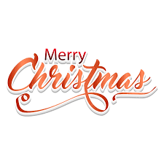
CONCLUSION
Be God’s instrument of liberation carrying good news of love, peace and salvation to the poor in this season of advent.
Be docile and attentive to the movement of the Spirit and the cry of the poor
Spend intentional time and deepen your intimacy with God as we get closer to the birth of the “Light of the World.” the Messiah, the Door of Hope.
Be ready for Christmas joys of the Mystery of Incarnation, celebrate with family and friends.
    Ps 118:24 - “This is the day the Lord has made, Let us rejoice and be glad in it”
Sr. M. Justine Naluggya-IHMR

Slide 12
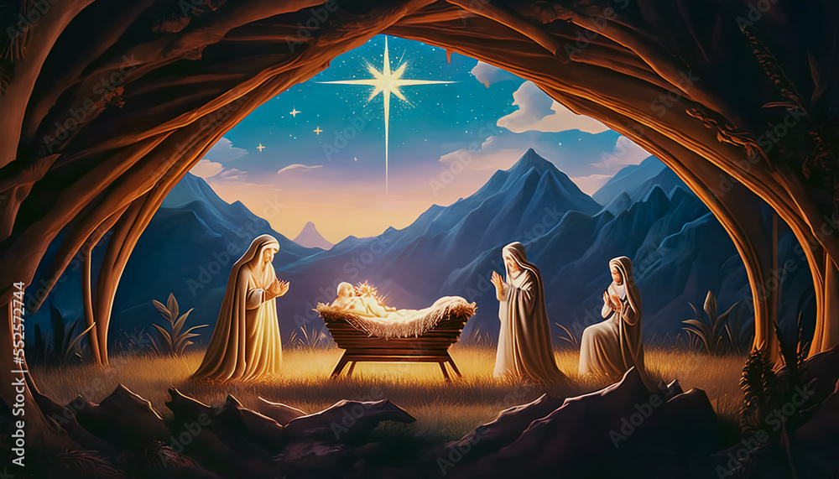
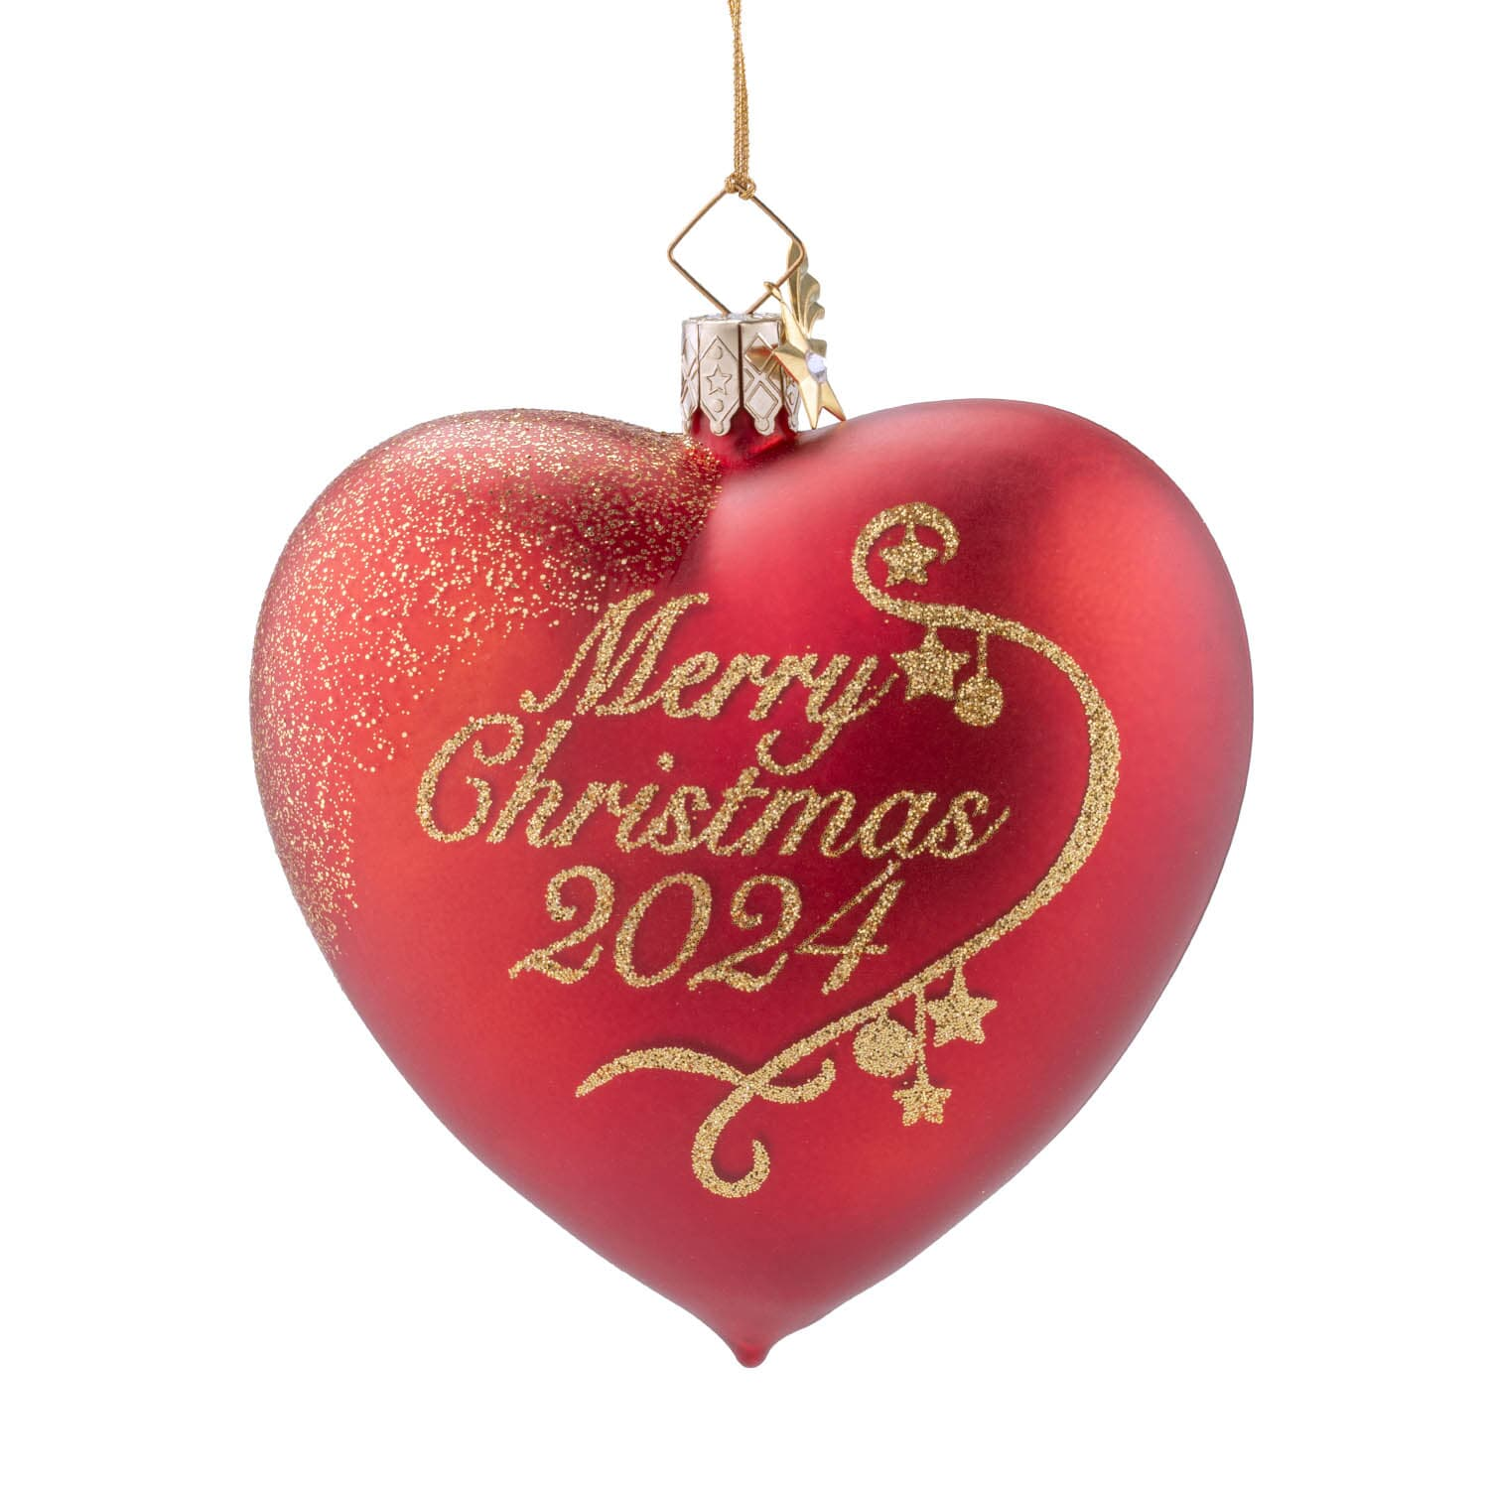
LORD,
WE PRAY THAT YOU BREAK ALL THE WALLS OF TENSIONS IN OUR LIVES AND OPEN
THE DOOR OF HOPE TO EMBRACE WITH CHEERFUL HEARTS THE JOYS OF CHRISTMAS AND THE KINGDOM OF PEACE, HAPPINESS AND HOLINESS
AMEN!
As Pilgrims of Hope, we are called to culvate and deepen prayer life, faith and charity which are the major keys to christian Hope.
Pilgrim journey of Hope, is one of rediscovering God’s intimate love for humanity and self rediscovery towards new life. Sr. M. Justine Naluggya-IHMR
THANK YOU
MUCHAS GRACIAS

